Slide 1

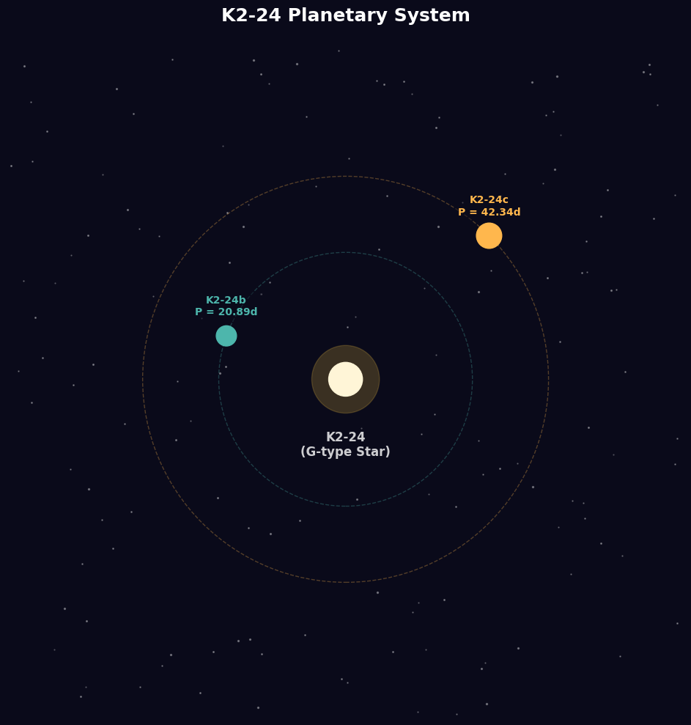
Deep Learning for Bayesian Computation
Applying Normalizing Flow Methods to Exoplanet Inference on K2-24
Daniel Christensen
Neural Inference | Exoplanet Orbital Dynamics

Slide 2

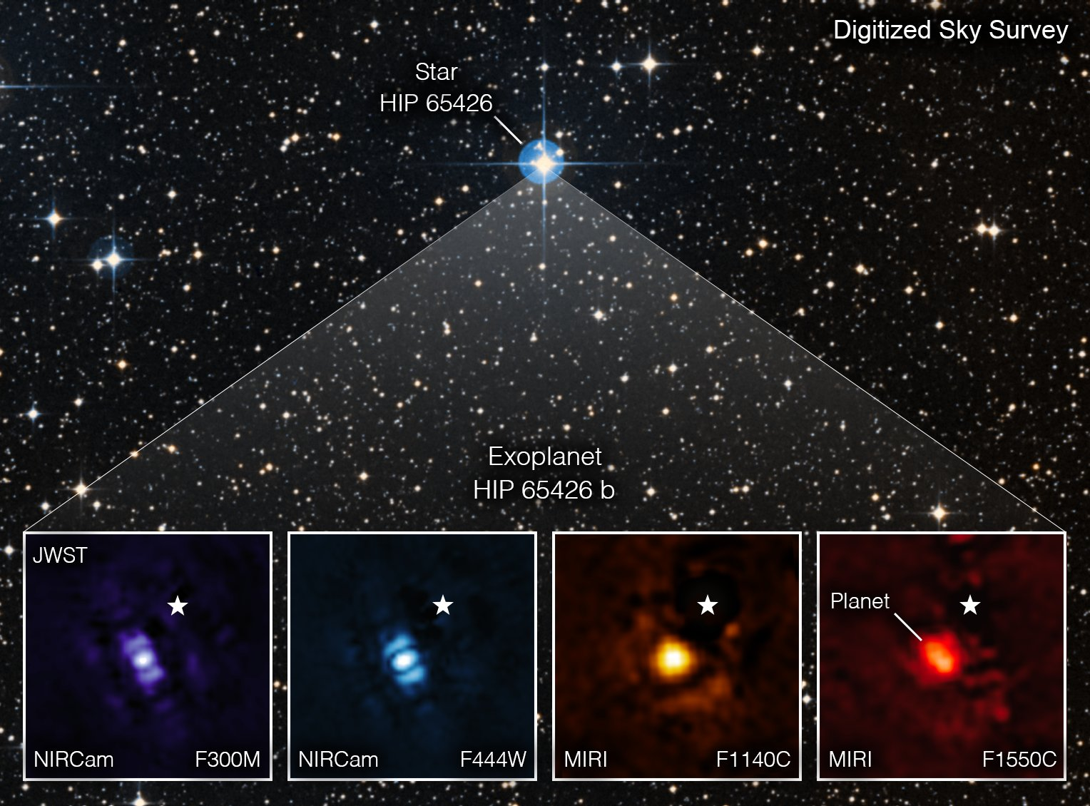
Why Exoplanet Inference?
Exoplanet astronomy has transitioned into an industrial-scale data challenge.
5000+ confirmed exoplanets to date
Radial velocity (RV) is a dominant indirect method
Posterior characterization defines habitability claims
image of an exoplanet captured by the James Webb Space Telescope.
Credit goes to NASA/ESA/CSA, A Carter (UCSC), the ERS 1386 team, and A. Pagan (STScI).

Slide 3







PAIRED COMPARISON FRAMEWORK
HMC Baseline
Flow-MCMC
Mean-Field VI
Flow VI
Standard Hamiltonian Monte Carlo for exact but often slow sampling.
Adaptive flow proposals to bridge multimodal gaps (Gabrié et al. 2022).
Fast but restricted Gaussian approximation baseline.
Highly expressive variational family via Planar Flows (Rezende 2015).

Slide 4
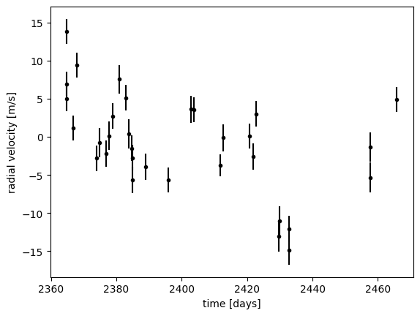
THE K2-24 DATASET
32 RV observations from Keck/HIRES, EPIC 203771098
System Properties
EPIC 203771098: A Sun-like star with two known transiting Neptunian planets. Spans ~ 100 days, with two known transiting planets: P_b = 20.89 d, P_c = 42.36 d.
32 RV observations from Keck/HIRES
100-day observational baseline
Ground truth periods from K2 photometry

Slide 5
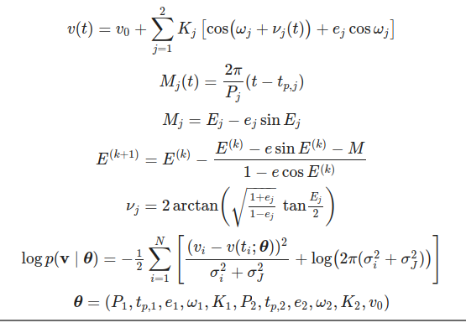
THE TWO-PLANET KEPLERIAN MODEL
Differentiable: Model implemented in PyTorch
Jitter: Absorbs unmodeled stellar activity
12 Parameters: P, tp, e, omega, K (x2) + v0, jitter
Newton Iteration: To invert Kepler's equation

Slide 6

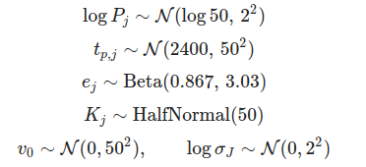
Weakly Informative Priors
Log Period: log P ~ N(log 50, 2²) — Coverage: 7 to 370 days
Periastron: tp ~ N(2400, 50²) — Centered on data epoch
Eccentricity: e ~ Beta(0.867, 3.03) — Calibrated via Kipping (2013)
Semi-amplitude: K ~ HalfNormal(50) — Weakly informative for RV signal
Log Jitter: log σJ ~ N(0, 2²) — Absorbs unmodeled stellar activity
Smooth priors avoid hard boundary gradients that could break VI optimization.

Slide 7






WHY THIS POSTERIOR IS HARD
High Dimensionality
Multimodality
Nonlinear Likelihood
12-D space precludes grid-based methods; requires intelligent exploration.
Period aliasing creates secondary modes at fractions of true periods.
Strongly nonlinear in P and e; local curvature varies wildly across the space.

Slide 8
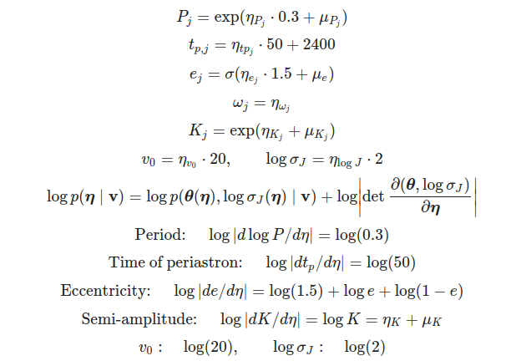
COORDINATE REPARAMETERIZATION
Result: Posterior geometry becomes isotropic in "eta" space, allowing uniform MCMC step sizes.

Slide 9

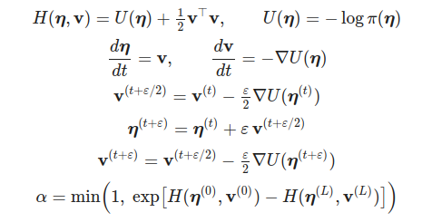
HAMILTONIAN MONTE CARLO
12 Chains | 500 samples each
Symplectic Leapfrog Integrator
Metropolis-Hastings correction
Augments posterior with auxiliary momentum variables. Trajectories stay on energy level sets, allowing long steps while maintaining high acceptance rates.
Config: L = 30 steps, ε = 0.01.

Slide 10
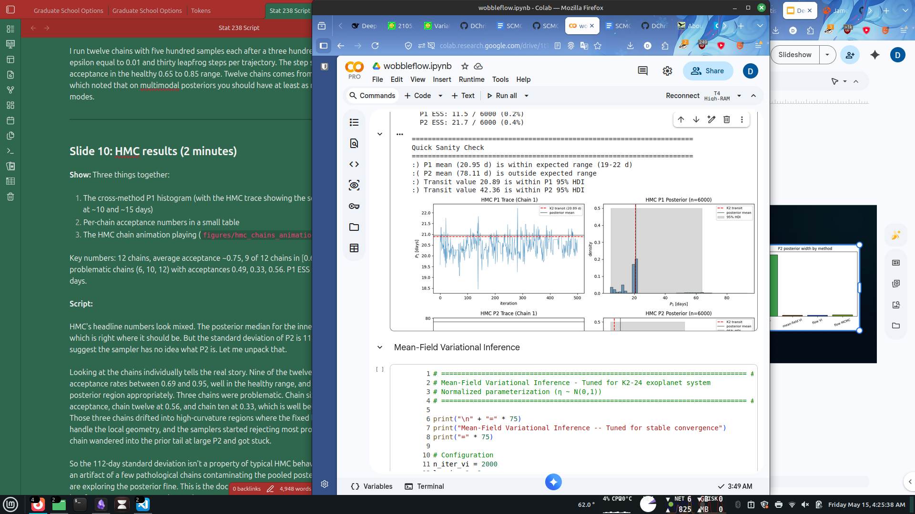
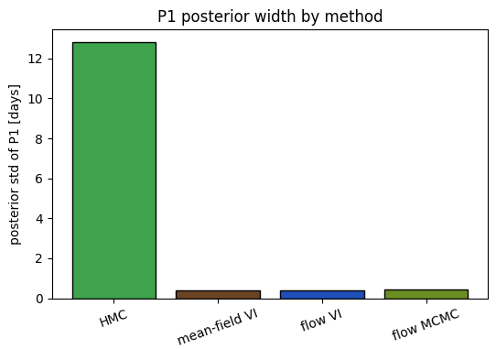
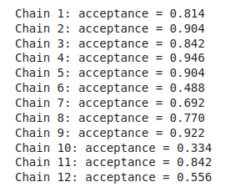
HAMILTONIAN MONTE CARLO RESULTS

Slide 11


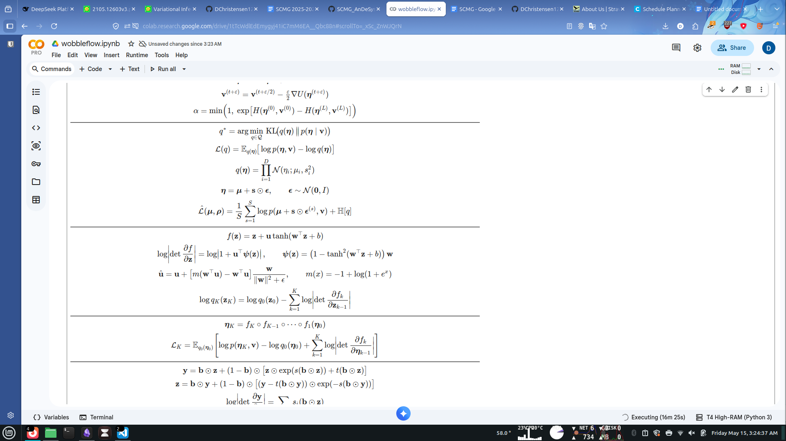
MEAN-FIELD VARIATIONAL INFERENCE
Optimizes the Evidence Lower Bound (ELBO) to approximate the posterior.
Mean-Field Factorization
q(η) = Π N(ηi; μi, si2)
Assumes zero correlation between parameters. Uses the reparameterization trick for gradients.
Config: 2000 iterations, Adam @ lr=1e-2, 64 ELBO samples per gradient step, log_s init = -3

Slide 12

NORMALIZING FLOW-BASED VARIATIONAL INFERENCE
Planar Flows
Captures complex correlations by warping a base Gaussian through 8 invertible planar layers.
Strictly better ELBO than Mean-Field.
Config: 8 planar layers, Adam @ lr=1e-3, 5000 iterations, 32 ELBO samples per step.

Slide 13
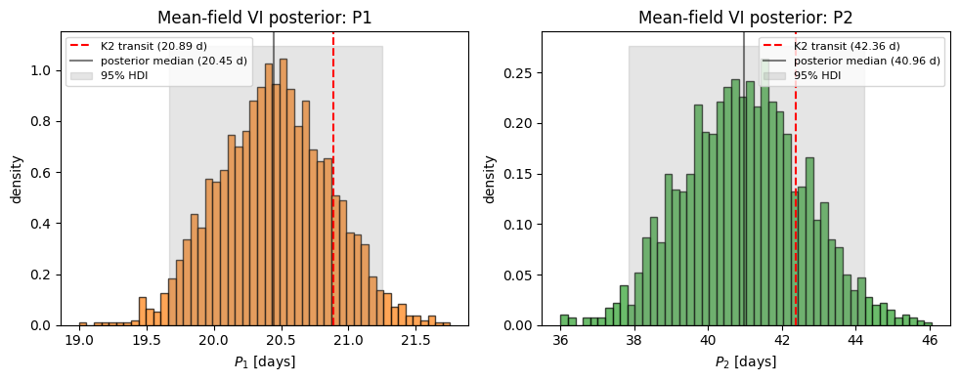
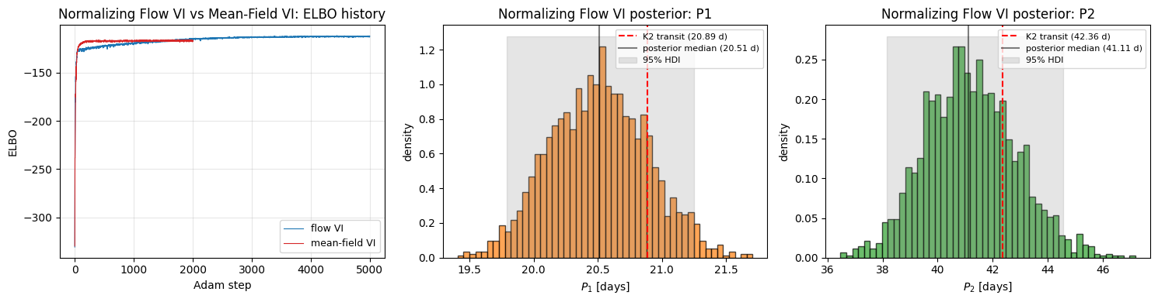
Variational Inference Methods Comparison
Mean-field final ELBO = -116.49,
Flow VI final ELBO = -112.26,
ΔELBO ≈ 4 nats,
P1 std mean-field = 0.411
vs
Flow VI = 0.379.

Slide 14
Normalizing Flow MCMC
Config: 24 chains × 600 outer iterations
MALA τ = 5e-4
RealNVP with 6 layers and hidden=64, warmup of 50 iterations
training buffer size = 2000.
Compound Kernel: Combines local MALA moves with global Flow proposals.
Real-NVP architecture (6 layers)
Adaptive training on chain history
Enables jumping between distant modes

Slide 15
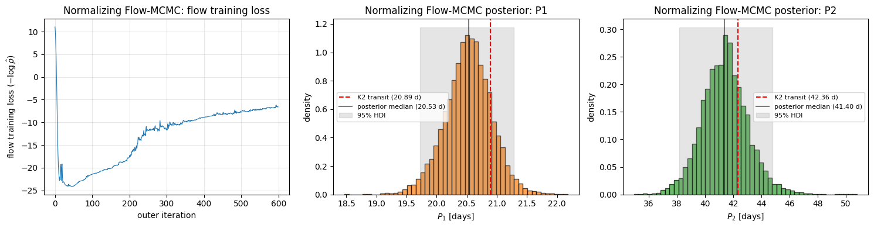
Normalizing Flow MCMC Results
Local MALA acceptance = 0.36
Global flow acceptance = 0.02
P2 std = 2.47 days
All four sanity checks pass.

Slide 16
Side-by-Side Chain Comparison

Slide 17
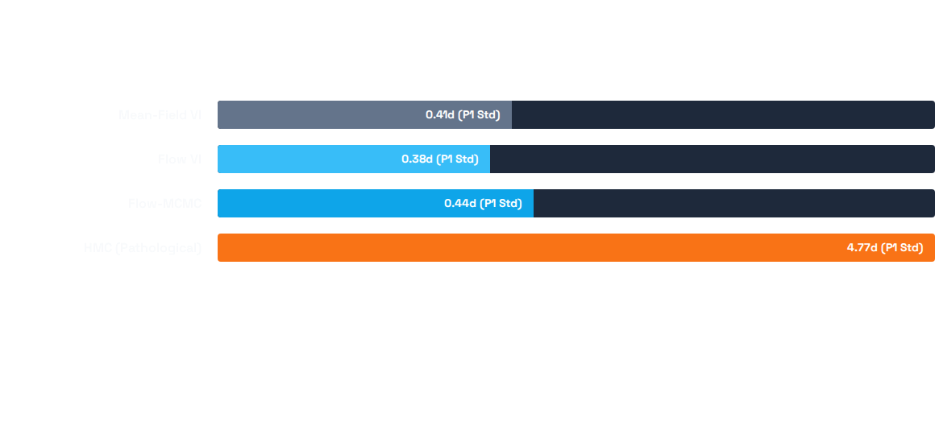
CROSS-METHOD PERFORMANCE
Method | P1 std (day) | P2 std (day) | Final ELBO
Hamiltonian Monte Carlo | 12.81 | 111.85 | —
Mean-Field Variational Inference | 0.41 | 1.63 | -116.49
Normalizing Flow Variational Inference | 0.38 | 1.65 | -112.26
Normalizing Flow MCMC | 0.44 | 2.47 | —
VI offers confident but potentially over-confident unimodal fits. MCMC provides honest multimodal exploration.

Slide 18
SUMMARY & FUTURE DIRECTIONS
Core Findings
What's Next?
Flow VI strictly improves on mean-field VI in ELBO (~4 nats), but mostly through joint correlations rather than marginal shapes
Use Real-NVP as the Flow-VI backbone
Tighter priors on semi-amplitude (K)
Flow-MCMC produces more robust posteriors than vanilla HMC, with cleaner uncertainty estimates and chain-wandering protection
R-hat Diagnostics across chains
Both flow methods are useful incremental improvements, not complete solutions

Slide 19
References
Rezende, D. J.; Mohamed, S. Variational Inference with Normalizing Flows. Proceedings of the 32nd International Conference on Machine Learning (ICML) 2015, 37, 1530-1538.
Gabrié, M.; Rotskoff, G. M.; Vanden-Eijnden, E. Adaptive Monte Carlo Augmented with Normalizing Flows. Proc. Natl. Acad. Sci. U.S.A. 2022, 119 (10), e2109420119.
Neal, R. M. MCMC Using Hamiltonian Dynamics. In Handbook of Markov Chain Monte Carlo; Brooks, S., Gelman, A., Jones, G. L., Meng, X.-L., Eds.; Chapman and Hall/CRC: Boca Raton, FL, 2011; pp 113-162.
Duane, S.; Kennedy, A. D.; Pendleton, B. J.; Roweth, D. Hybrid Monte Carlo. Phys. Lett. B 1987, 195 (2), 216-222.
Dinh, L.; Sohl-Dickstein, J.; Bengio, S. Density Estimation Using Real NVP. International Conference on Learning Representations (ICLR), 2017.
Roberts, G. O.; Tweedie, R. L. Exponential Convergence of Langevin Distributions and Their Discrete Approximations. Bernoulli 1996, 2 (4), 341-363.
Kingma, D. P.; Welling, M. Auto-Encoding Variational Bayes. International Conference on Learning Representations (ICLR), 2014.
Blei, D. M.; Kucukelbir, A.; McAuliffe, J. D. Variational Inference: A Review for Statisticians. J. Am. Stat. Assoc. 2017, 112 (518), 859-877.
Jordan, M. I.; Ghahramani, Z.; Jaakkola, T. S.; Saul, L. K. An Introduction to Variational Methods for Graphical Models. Mach. Learn. 1999, 37 (2), 183-233.
Kipping, D. M. Parametrizing the Exoplanet Eccentricity Distribution with the Beta Distribution. Mon. Not. R. Astron. Soc.: Lett. 2013, 434 (1), L51-L55.
Petigura, E. A.; Howard, A. W.; Lopez, E. D.; et al. Two Transiting Low-Density Sub-Saturns from K2. Astrophys. J. 2016, 818 (1), 36.
Geyer, C. J. Practical Markov Chain Monte Carlo. Stat. Sci. 1992, 7 (4), 473-483.
Fulton, B. J.; Petigura, E. A.; Blunt, S.; Sinukoff, E. RadVel: The Radial Velocity Modeling Toolkit. Publ. Astron. Soc. Pac. 2018, 130 (986), 044504.

Slide 20

Image Source
https://cdn.esawebb.org/archives/images/wallpaper5/HIP-65426b.jpg
Source: esawebb.org

